Slide 1
PETS
OUR FRIENDS

Slide 2
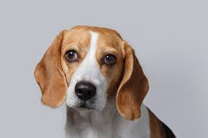
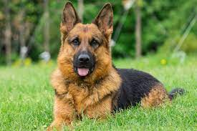
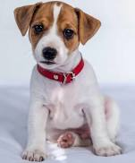
DOG
THE DOG IS A FAITHFUL
FRIEND OF MAN.

Slide 3
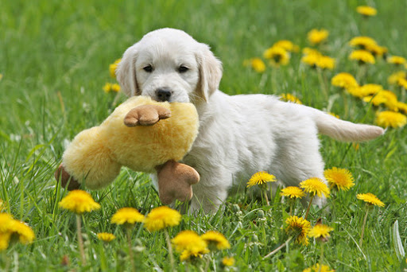
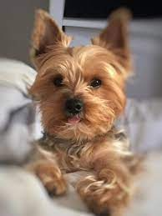
THE DOG SHOWS HIS LOVE EVERY DAY.

Slide 4
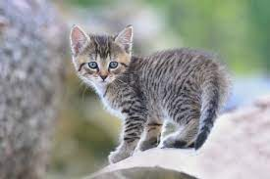
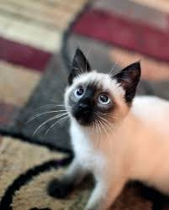
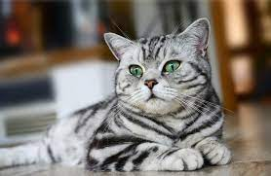
CAT
CATS ARE FLUFFY, FRIENDLY
ANIMALS MOST.

Slide 5
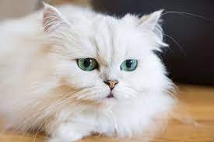
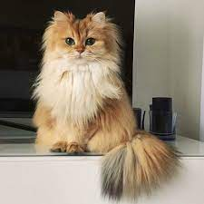
OFTEN SPEND THEIR TIME ON THE COUCH OR NEAR THE RADIATOR.

Slide 6
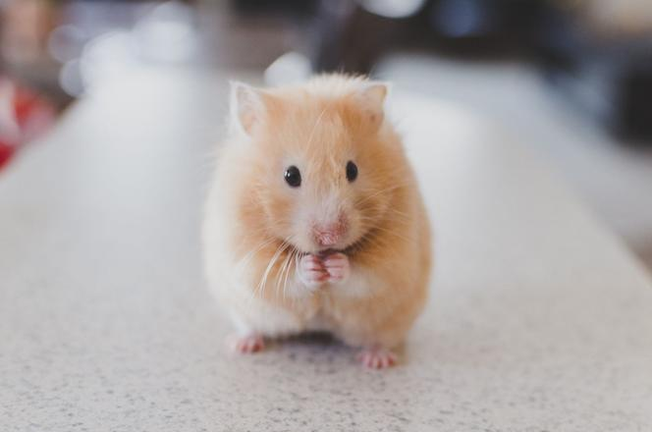
HAMSTER
THE HAMSTER IS A SMALL
RODENT.

Slide 7
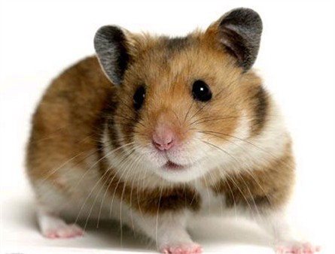
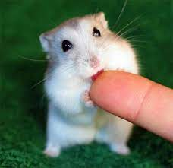
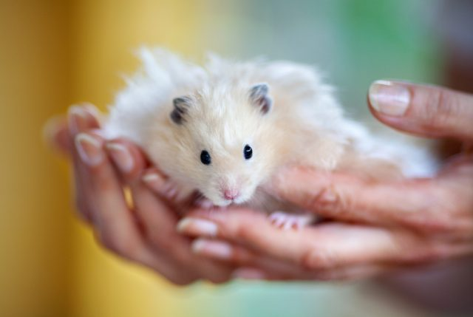
HE IS VERY ACTIVE, RUNS AROUND THE CAGE AND SMILES BEAUTIFULLY.

Slide 8
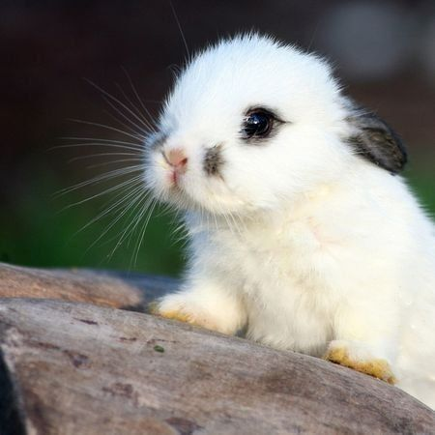
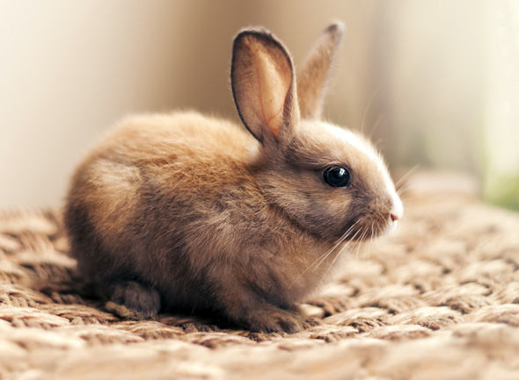
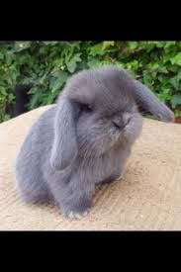
RABBIT
THE MINIATURE.

Slide 9
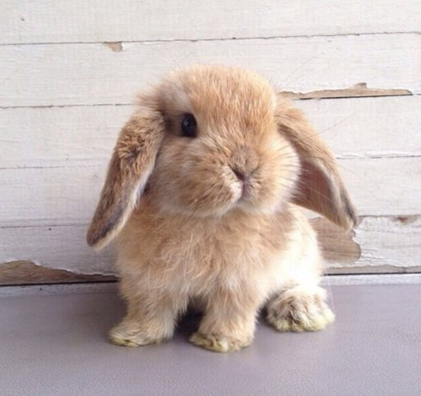
THE RABBIT IS A LIVING PLUSH FAVORITE OF CHILDREN AND ADULTS.

Slide 10
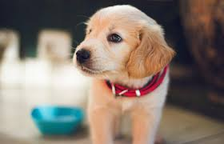
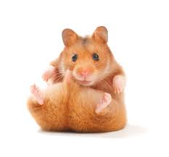
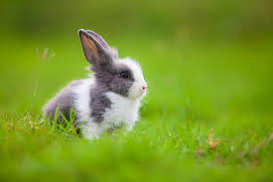
THANK YOU FOR YOUR ATTENTION. Angelika Żarnowiecka kl.7a

